Slide 1
Data Science Application
Capstone Project:
Determining the Best Neighborhood in Toronto, Canada

Slide 2
Overview of the Presentation
Introduction
Source of Data
Methodology
Results
Conclusions

Slide 3
Introduction
When a potential immigrant to Canada contemplates a possible move to Toronto, it would be helpful to be able to research and learn about the different neighborhoods in advance.
The decision-making process can be overwhelming, and having a methodical approach to evaluating the different areas of Toronto, Canada would be useful and practical for potential immigrants.
Which neighborhood in Toronto, Canada is the best or most appealing to a potential immigrant?
Data Science methodologies and techniques can help create a system which can help evaluate and confirm the best neighborhood that a potential immigrant can choose in Toronto.

Slide 4
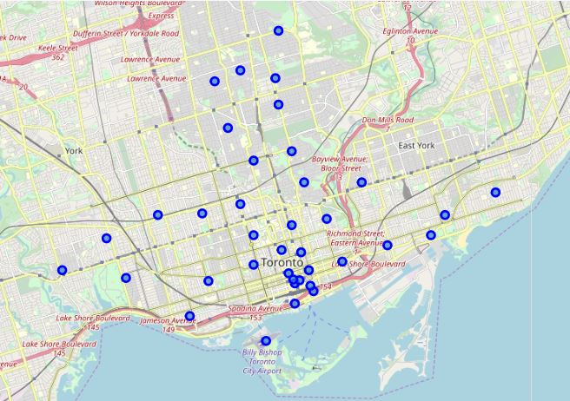
Source of Data
Information about the postal codes related to Toronto and its different neighborhoods was obtained through the Wikipedia website: 'https://en.wikipedia.org/wiki/List_of_postal_codes_of_Canada:_M’.
The following boroughs were studied: Downtown Toronto, East Toronto, West Toronto and Central Toronto.
Geographical coordinates for the different areas were also obtained and mapped.
Four Squares API database was used to extract venue-specific information about the boroughs.

Slide 5
Methodology
To determine which neighborhood in Toronto, Canada is the most desirable to a potential immigrant, data from the Wikipedia website was scraped, wrangled and cleaned.
The geographical details for Downtown Toronto, East Toronto, West Toronto and Central Toronto were obtained from https://cocl.us/Geospatial_data.
Four Squares API database was used to gather venue-related information about the different neighborhoods.
One-hot encoding was performed for the venues.
K-Means Clustering was completed to segment the neighborhoods into 5 clusters.
The centers of the five clusters were analyzed according to which one had the most number of venues within 1 km, and the one with the highest number was identified as the best neighborhood in Toronto.

Slide 6
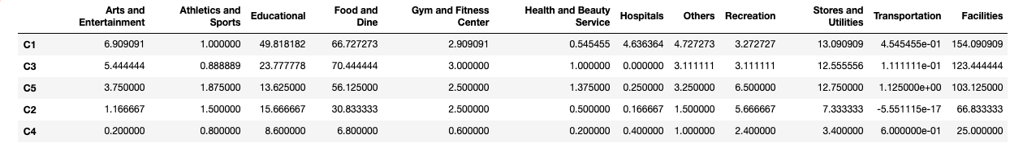
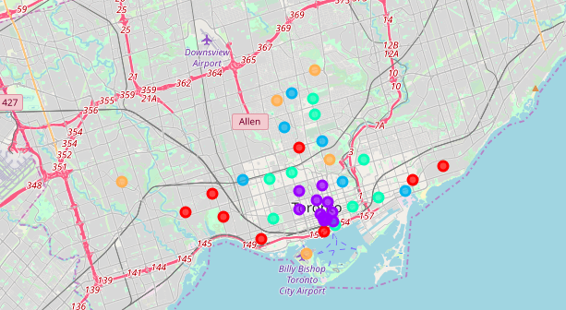
Results
Cluster 1 has the highest number of facilities and it is classified as the “best” area in Toronto, Canada, followed by Clusters 3, 5, 2 and 4.

Slide 7
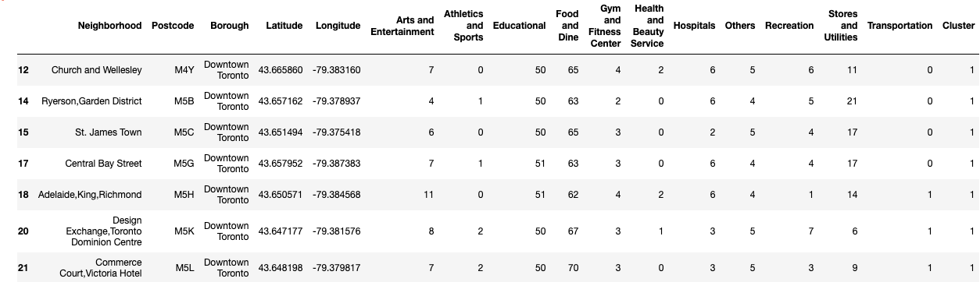
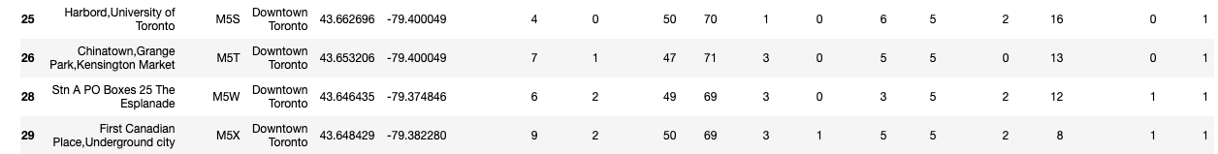
Results
The most desirable neighborhoods and their specific geographical points are listed in the above table for Cluster 1.

Slide 8
Conclusions
Data Science helps create a methodical approach to answering the question of which area in Toronto is best for a potential immigrant to Canada.
This tool can be utilized in evaluating possible moves to other neighborhoods and which ones offer the most in terms of venues.
A future supplementary study can be done to integrate the cost-of-living required in different neighborhoods in Toronto, in order to determine whether Cluster 1 is truly the best area to immigrate to.

